Slide 1

Introduction to Frontend Development

Slide 2
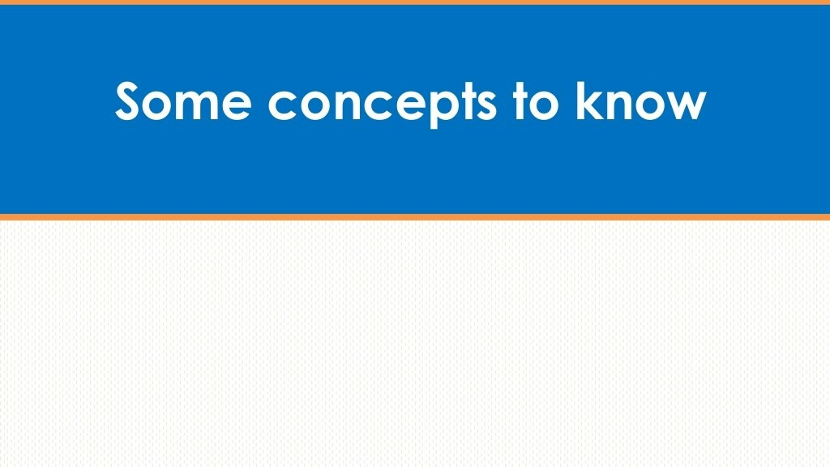
What is Front End Development?
The front end is basically the front layer of your website. It includes the design, content, and functionality – in other words, all the things that users interact with: Fonts, buttons, tables, menus, colors, etc.
The front end links the graphic user interface (GUI) with the execution of actions.
If your laptop were a website, your keyboard, display, mouse, and all other buttons would be the front-end. Those are the things you see, click, and touch. Anything on the inside – like your hard drive, video card, and processor, is the back end.

Slide 3
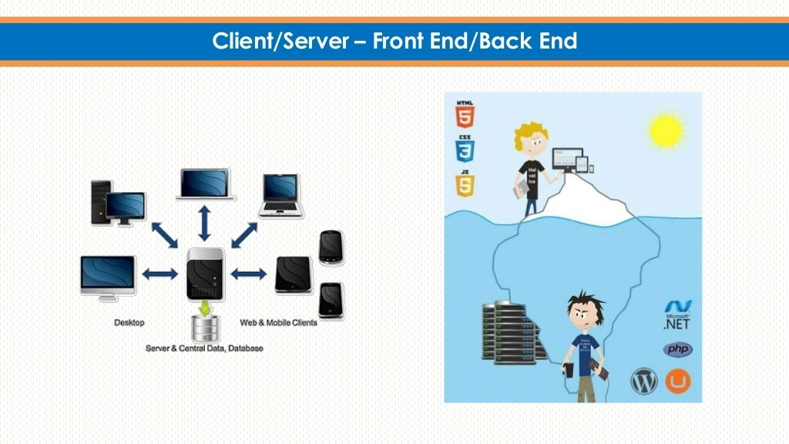

Slide 4
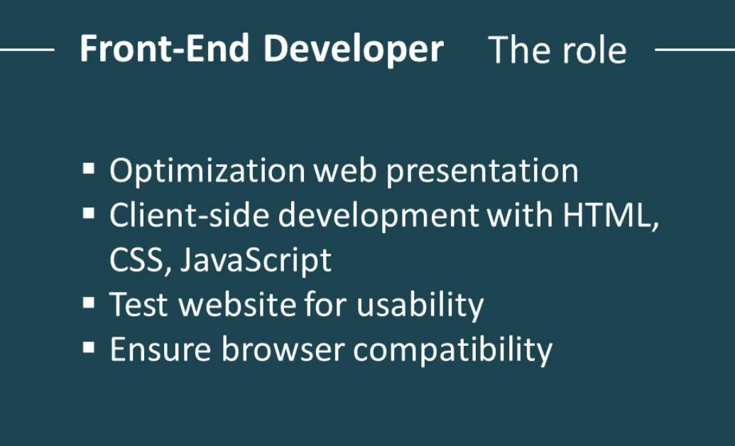

Slide 5
Now that you know what a front-end development is, answering this second question is pretty easy. The job of a front end developer is to create anything the user interacts with.
Therefore, a front-end developer will use programming languages such as HTML, CSS, and JavaScript – we’ll get into those in a second. But there are other things a front-end programmer must optimize – the speed and efficiency of a website so that the site offers an outstanding user experience.
Front end developers must be analytical, creative, and have a good technical base to create interfaces that work.

Slide 6
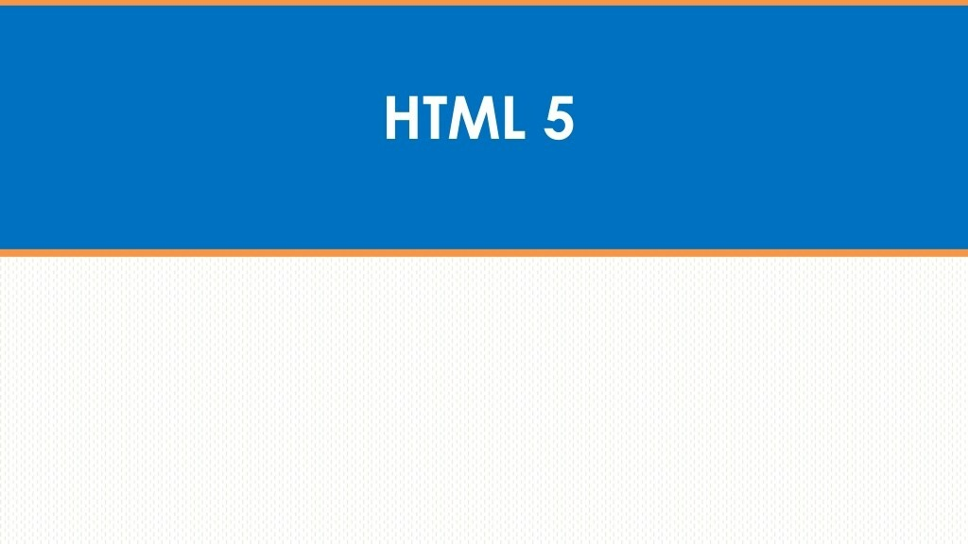
HTML will probably be one of the first things you learn how to use. It will provide the first building blocks of your website, its initial structure. Using HTML, you will be placing images on your website, determining fonts and putting up hyperlinks. HTML is one of the two most important components you need to build a website.

Slide 7
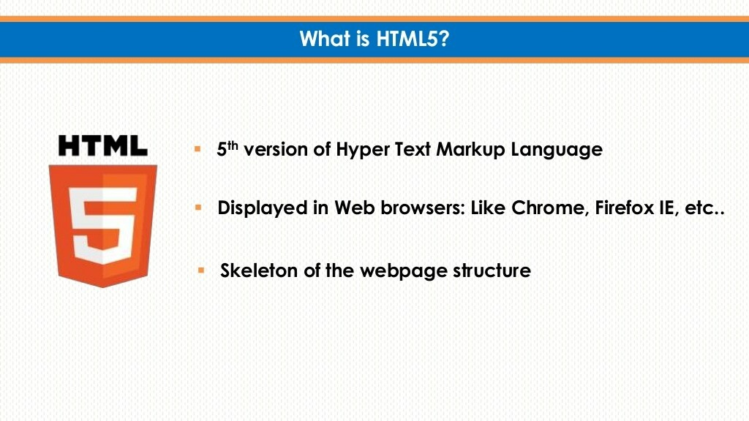

Slide 8
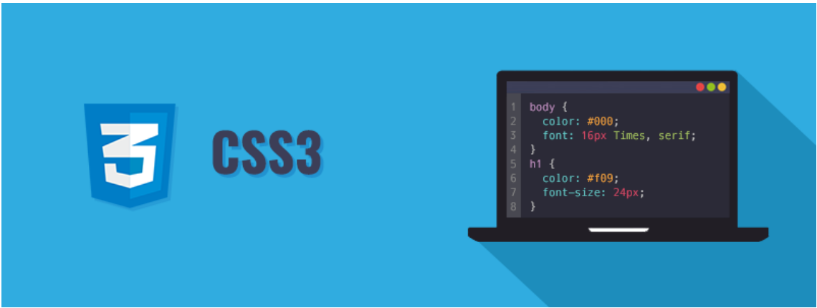
CSS is the second basic element. This is where the layout happens – it is where you decide how the elements of HTML will be displayed. Colors, backgrounds, transitions, and animations are all things you will be doing with CSS. Using these two components, you will be able to create a basic website.

Slide 9
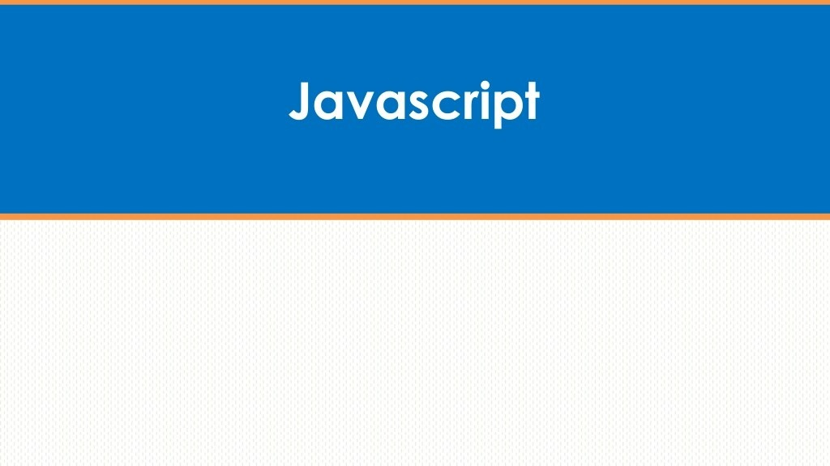
But to make a really good website, you will want to also know Javascript. Using this programming language, you will be able to add all sorts of interactions to your website – maps that update in real-time, videos that can be interacted with and even little games.

Slide 10
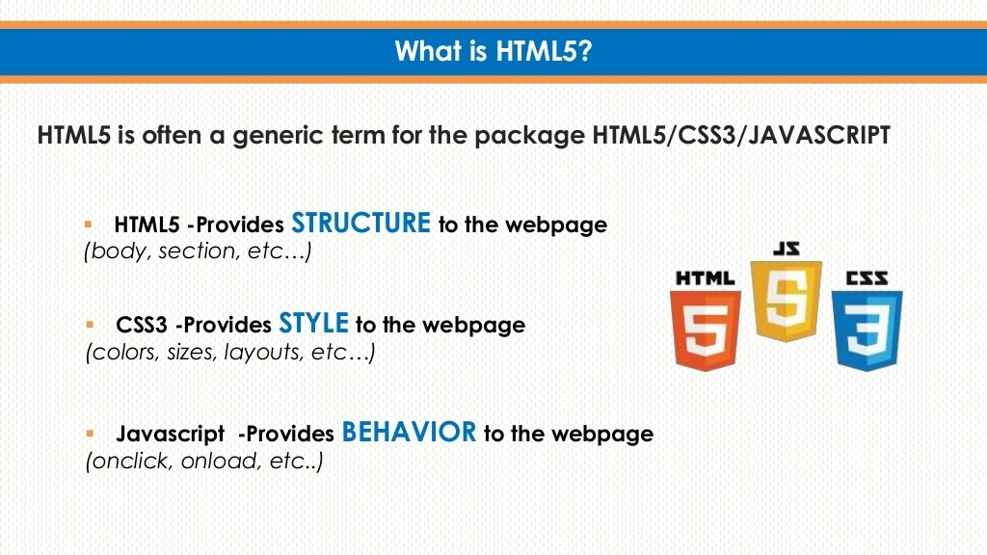

Slide 11
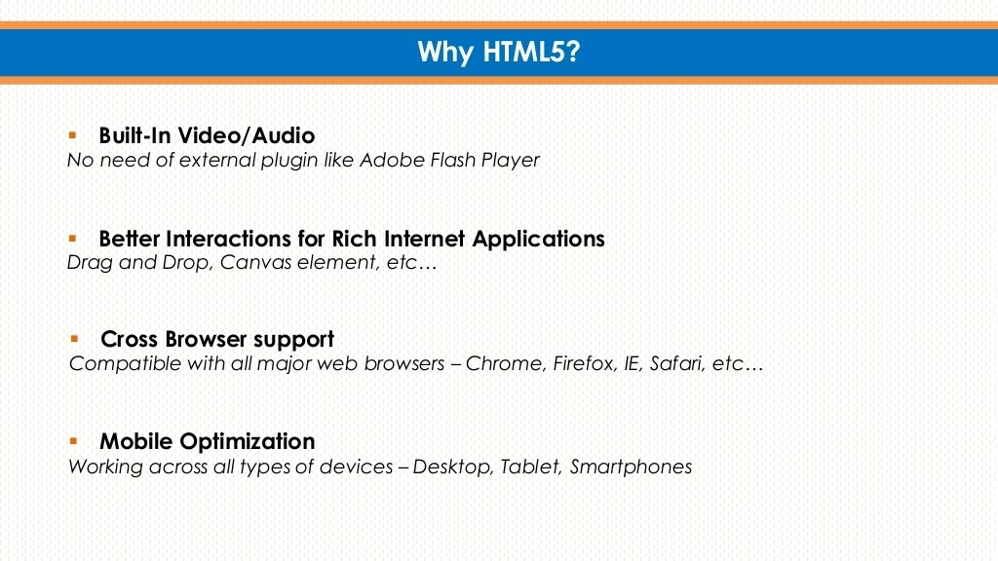

Slide 12
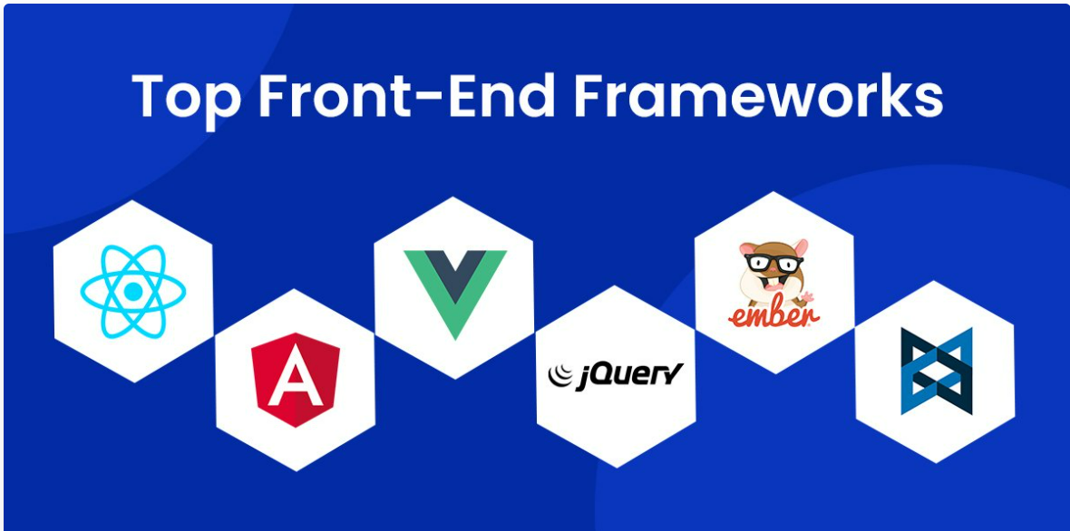
Besides these regularly used languages, you will need to go deeper and learn how to work with frameworks, which will help you code quickly with libraries and ready-made structures.
The probably most popular one is Bootstrap, that makes your site compatible with all browsers and ensures your website will look great no matter the size of your screen (remember: mobile first!). Besides Bootstrap, JavaScript frameworks such as AngularJS, Backbone, ReactJS, or Ember will assist you when working with JavaScript.

Slide 13
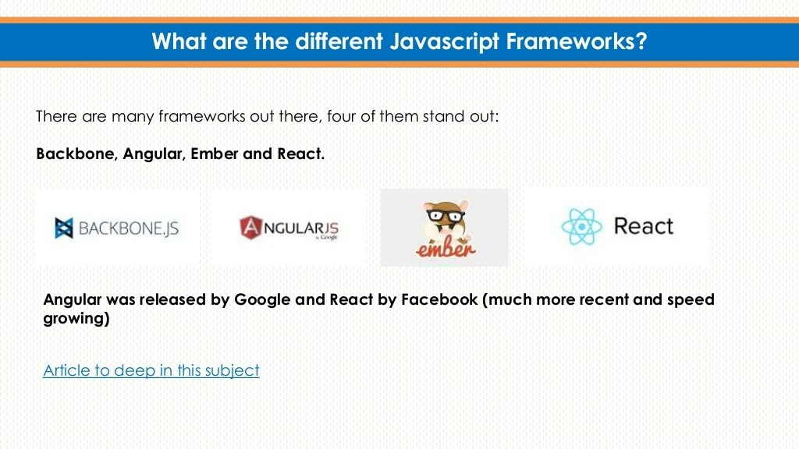

Slide 14


Slide 15
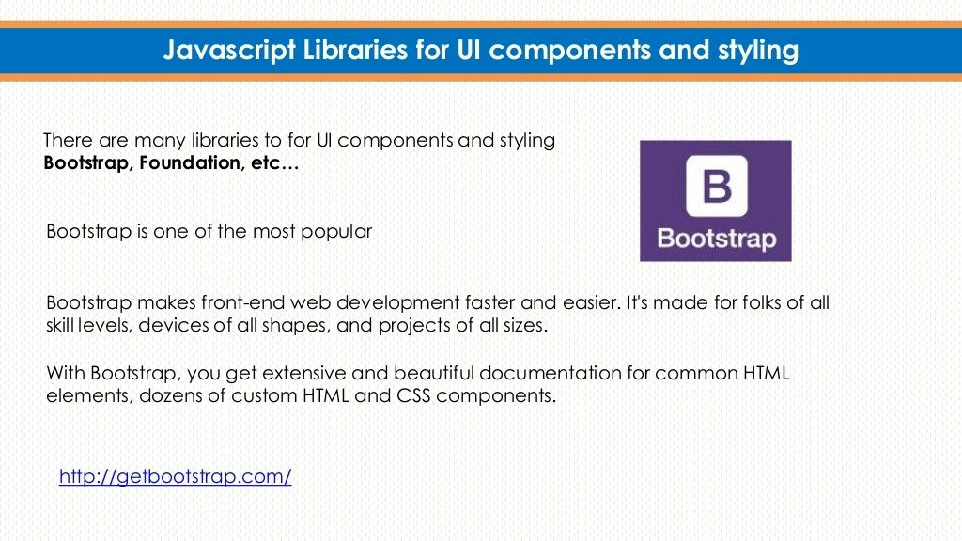

Slide 16
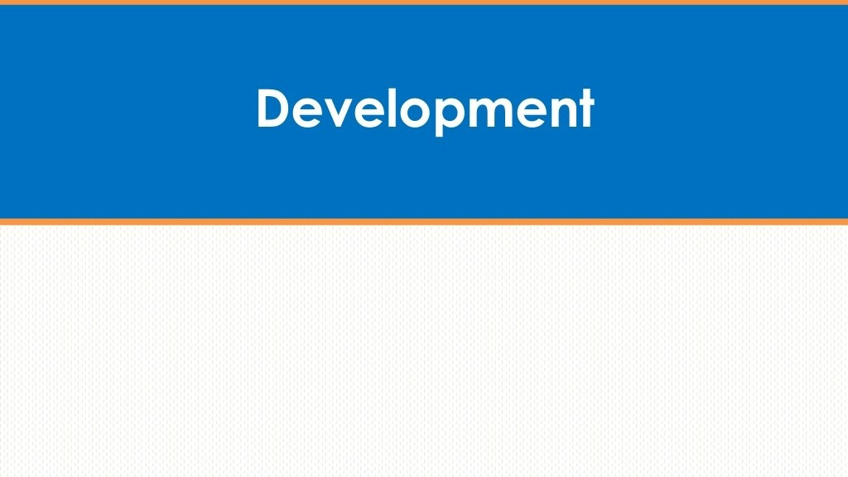
Responsive and UX/UI design
Having a responsive design is one of the most important things for front-end developers. Responsive design is how you make sure that your site functions and looks good regardless of the device a visitor might be using – whether it is an iPad, a phone, or a big desktop computer.
Besides, they need an eye for design as well as a good understanding of user interface design (UI design) and user experience (UX).

Slide 17

Front end programmers also need to know how to optimize the performance of a website. It’s not just about looking good, you also want a website to load fast. If it doesn’t, chances are a lot of people are going to click that big red X button before you have the chance to show them your fancy design.
You’ll also have to test your performance, which you can help yourself with tools like Google’s PageSpeed Insights.

Slide 18
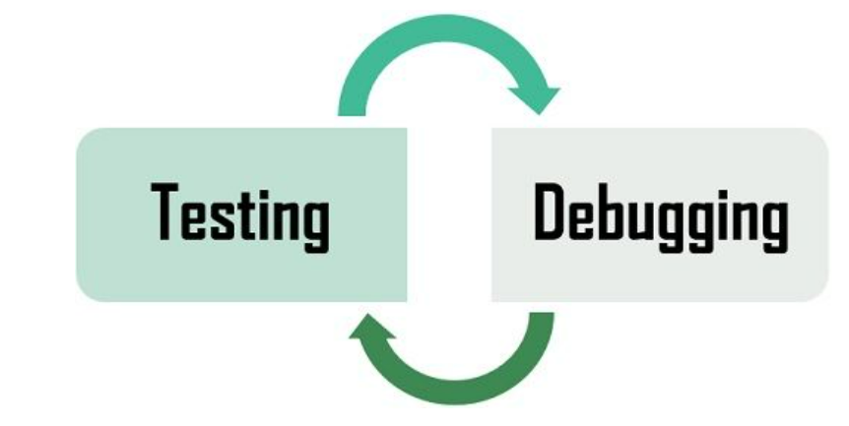
And last but not least, testing and debugging are essential front-end developer skills. Bugs happen all the time, mostly where you least expect them. There are different ways to look for bugs and remove them and you will have to know several if you want to catch them all.
Mocha and Jasmin (both JavaScript frameworks) should be familiar for a front-end developer as these will help you find and fix problems that your product may have.
However, remember that every programming language and also every company has its own testing and debugging procedures, so it’s not something you can learn once and know forever.

Slide 19
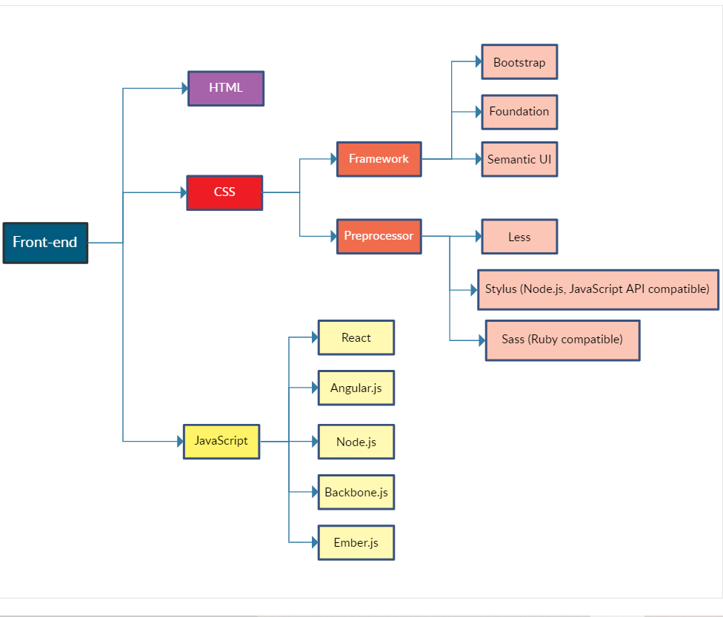
Road Map for Front-End Development

Slide 20

A great front-end developer should have soft skills like:
Attention to detail – A detail-oriented developer will focus on all task segments as well as how they are implemented. I would see whether the developer pays attention to the details of a project in order to create the best product.
Learning Attitude - The world of web development is never stagnant, there’s always something new to explore and learn. A curious web developer will keep improving and upgrading his or her set of skills. I would look for the curiousness and passion of the developer for the chosen field.

Slide 21
Creativity – I would also look for a skilled web developer who will be creative enough to get around, over and under any issues that pop up to ensure a seamlessly functioning website. In addition to being about to find or create solutions, he or she should know what course is best to take for solving a problem.
Look for their Portfolios and Online Presence
Viewing and discussing their portfolio is the best way to screen a developer. When looking for a front-end developer, I would look at how well they have put together their own online portfolio. This is something nobody paid them for, but they did in order to showcase their skills.

Slide 22

- By M.Saketh

